Slide 1
Manufacturing Data Collection and Analytics
Project Work
Option - II
Performed by students
Ajay Mishra
Shipon Nath
Kawshiqe Ahamed
Project supervisor: KOVALEV ILYA ALEXANDROVICH

Slide 2
Table OF Content:
Task: - | Done By: -
Create DB- Load All Data- Query 1, 2- | Ajay Mishra
Load xml file in Colab- Visualize the Data- Analysis the data- | Shipon nath
Run the xml file with Python- | Kawshiqe Ahamed

Slide 3
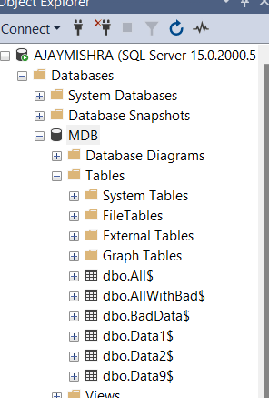
Create Data Base
-Created a data base including bad and good data,

Slide 4
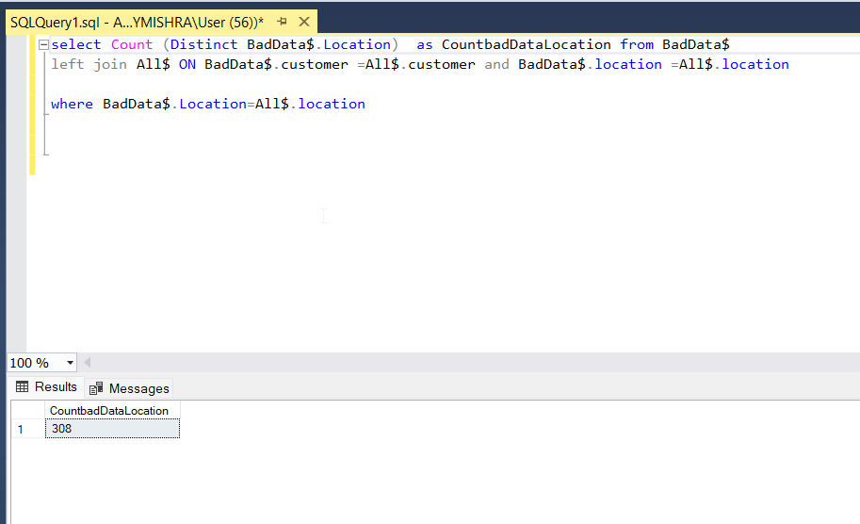
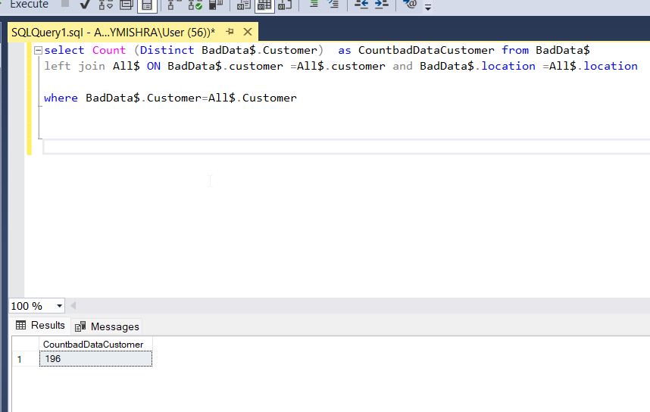
Data Manipulation to understand about bad data

Slide 5
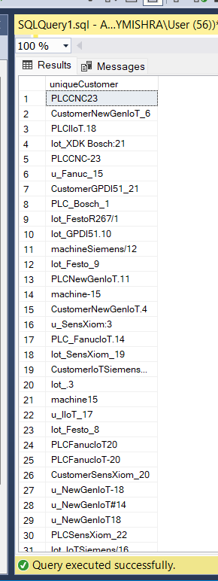
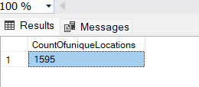
1)Count the number of unique Locations & 2)List Of Unique customer
Unique customer - Count- 14134

Slide 6
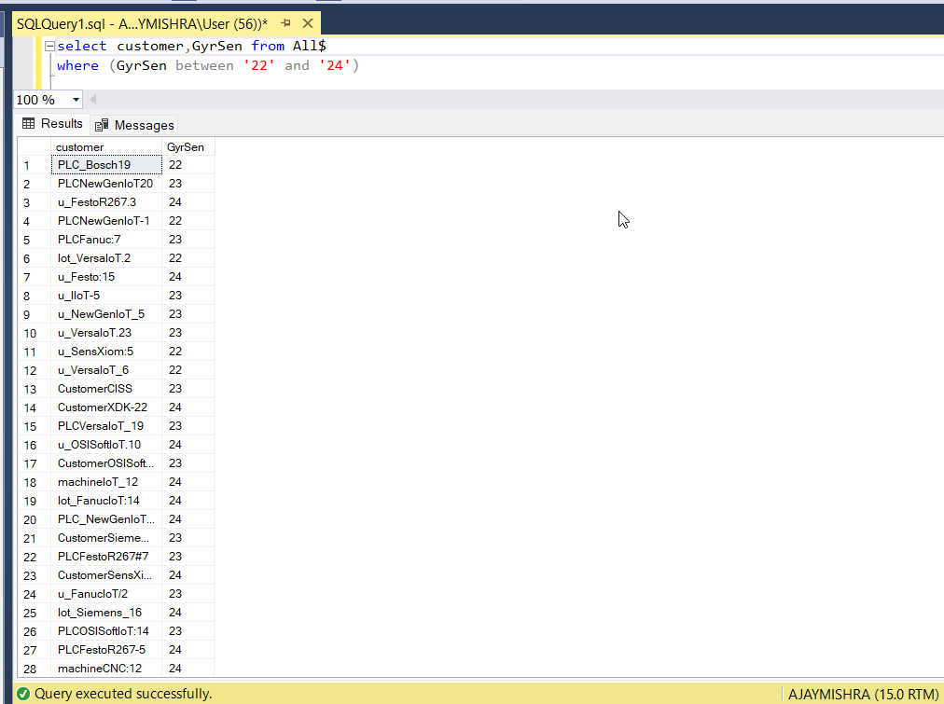
3) Find all Customers with GyrSen in the range between 22-24

Slide 7
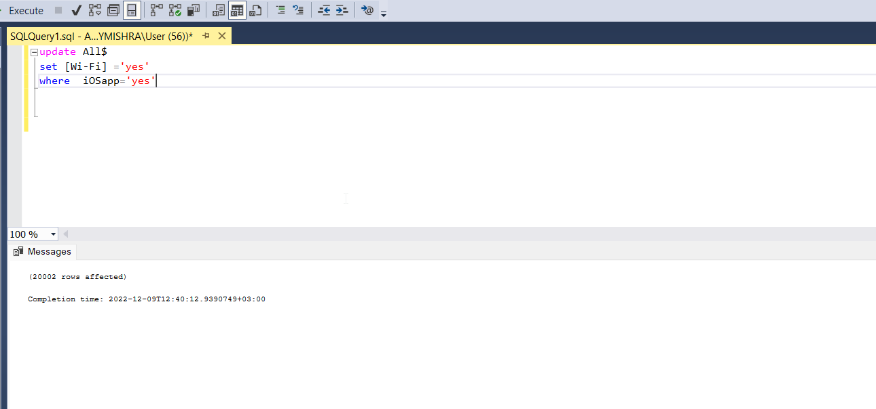
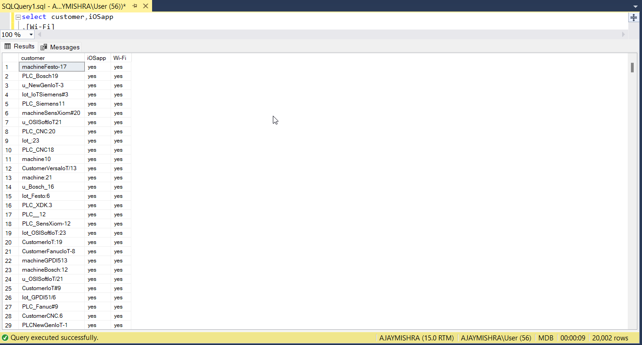
4)Find all ios app Customers that do not support wi-fi and update them to “yes”

Slide 8
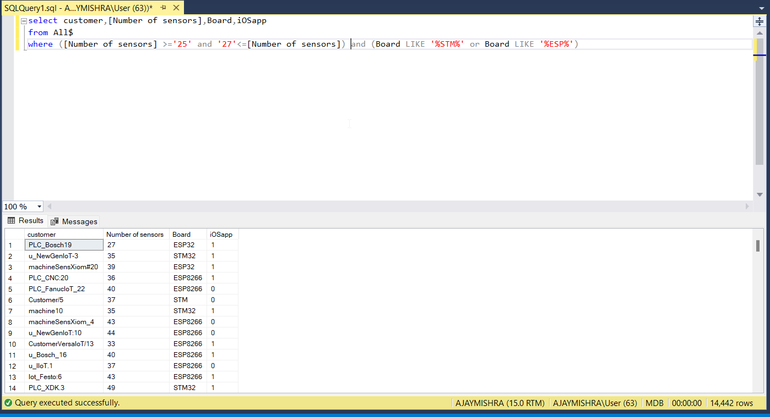
5)Find all Customers with a Number of sensor in the range between 25-27

Slide 9
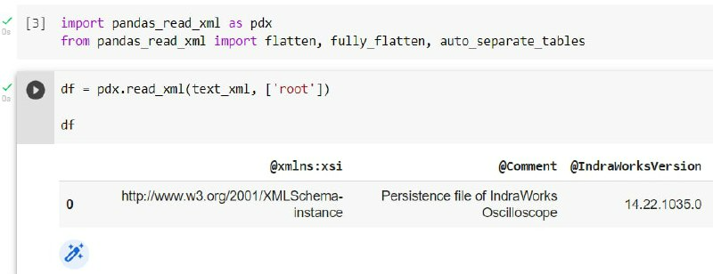
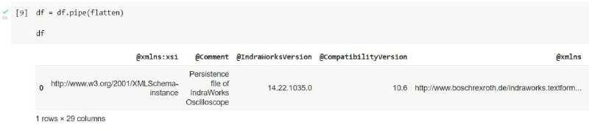
Run xml files with python

Slide 10
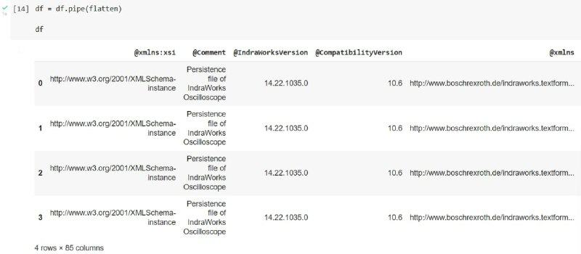
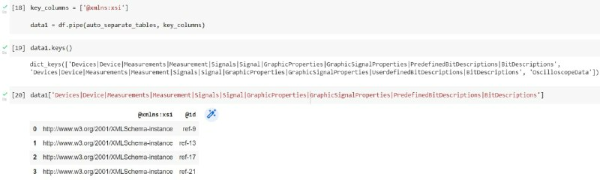

Slide 11
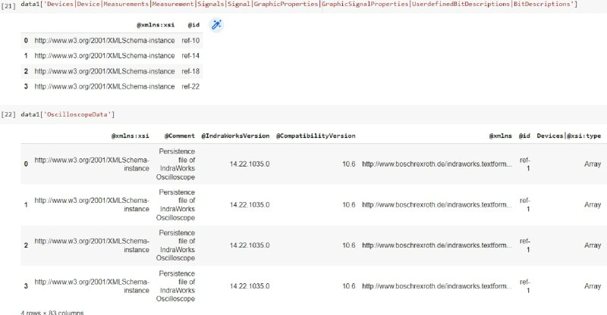
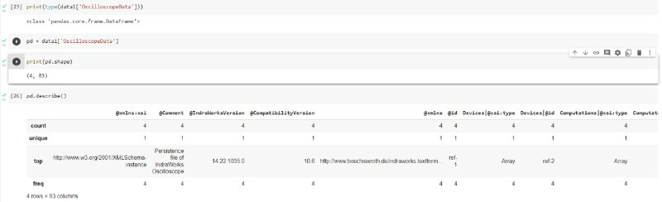

Slide 12
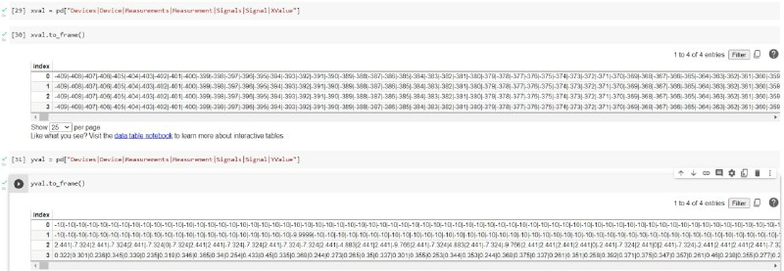

Slide 13
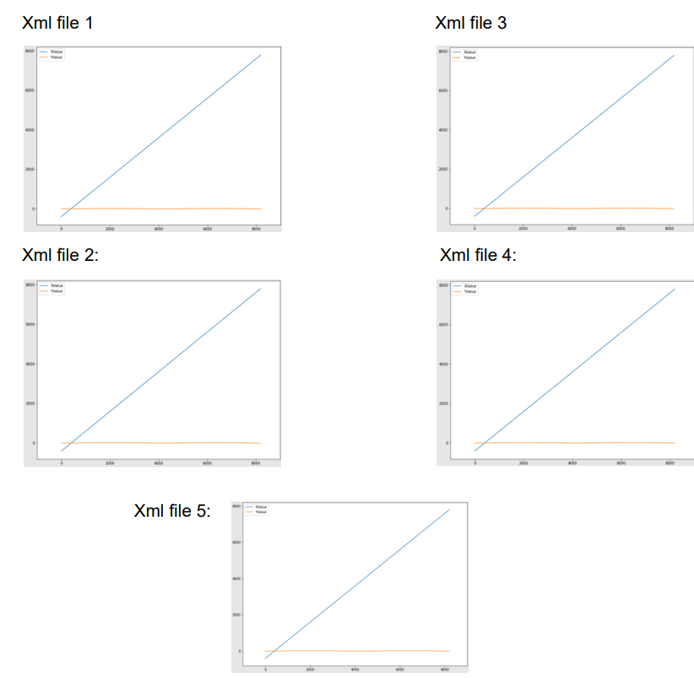
Data Analysis
Position Command Value:

Slide 14
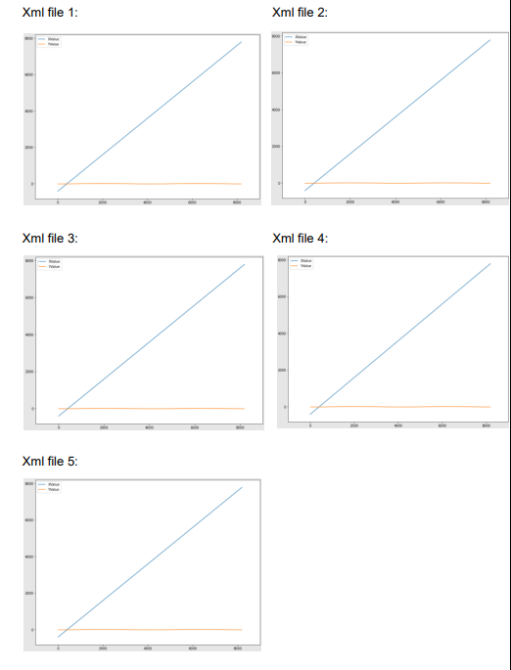
Position feedback value:

Slide 15
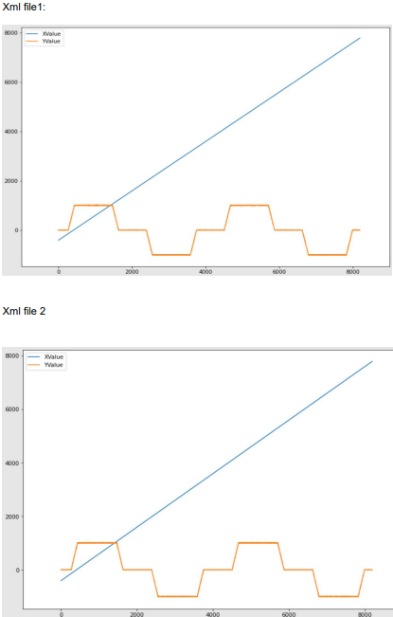
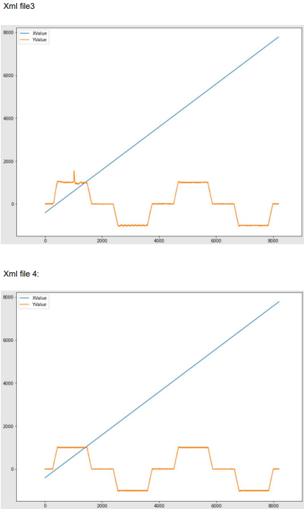
Velocity Feedback value:

Slide 16
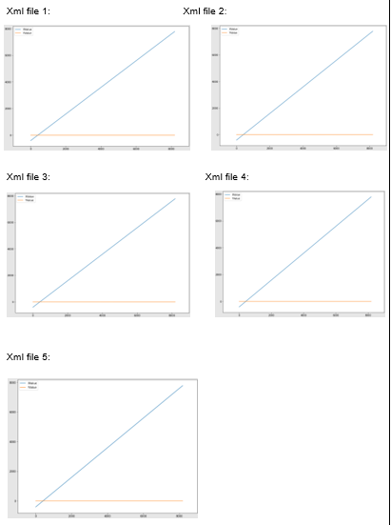
Actual output current value:

Slide 17
END

